Slide 1
Why should adults listen to children?
Child Friendly Cities and Communities
Children’s Week Initiative 2019

Slide 2
Earlier in the year we set a goal to capture the voice of young people in our community and share it as part of Children's week celebrations!
We asked the question: Why should adults listen to children?
This is how young people answered…

Slide 3
Survey Monkey Responses
A survey was set up to capture the voice of children.
64 Responses where captured in total!
Top 5 reasons cited by children as to why adults should listen to children:
Teach us how to listen by listening to us
Our opinions matter as we are the ones that have to live with the decisions
It’s a good way to understand us – we are growing up in a different world and we want to talk about and express how we feel
Adults could learn a thing or two – our ideas can be so thoughtful and creative that they could possibly change the world
We need you to listen so we feel safe to speak out if something does not seem quite right
“Because for the past centuries children have not had the fair share to talk. It was a problem for
women but now we are acknowledging that it's a problem with the children too”

Slide 4
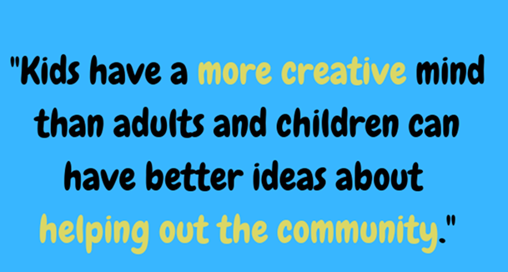

Slide 6
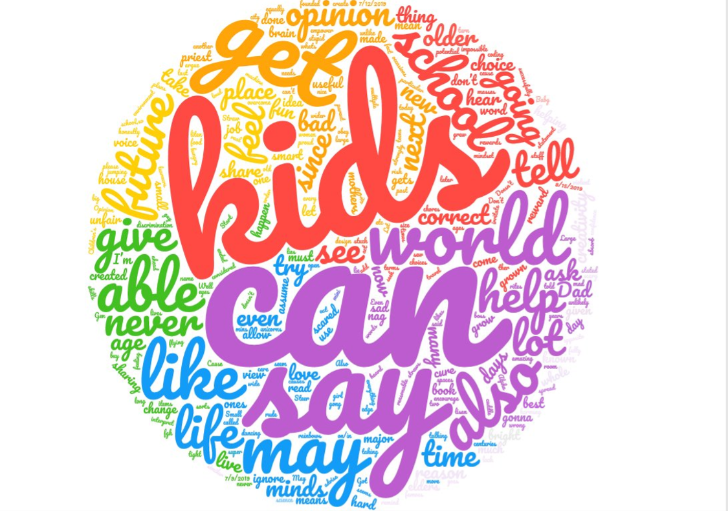

Slide 7
Young People from Cardinia Shire
Because things like building and toys are in our future, so we should design our future.
Because adults were once children, so know what it’s like to be a child.
Switch the question around to ‘why should children listen to adults?’
Because children have a different perspective- share ideas and work together.
More creative, e.g. playground consultation.
Adults overlook things.
Children think outside the box- adults are serious, children have fun.
Children can have great ideas to help the world.
More opened minded and more connected to the modern world.
We don’t think as realistically, with as many boundaries, we’re more creative, not as limited.
We’re the next generation- we want a good environment and community.
We’re living in a different world now.
Because we are amazing - we can think more creatively and design things adults are incapable of.

Slide 9
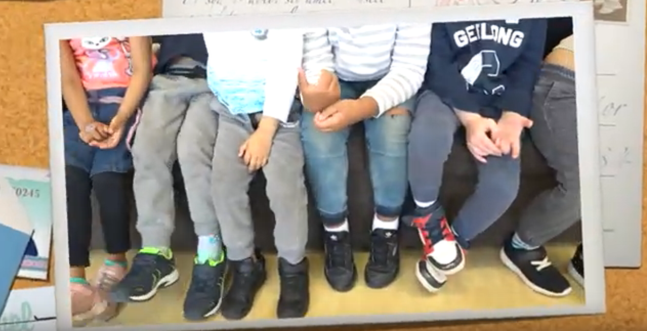
Young People from the City of Casey
https://youtu.be/rOaMtoiNFfc

Slide 10
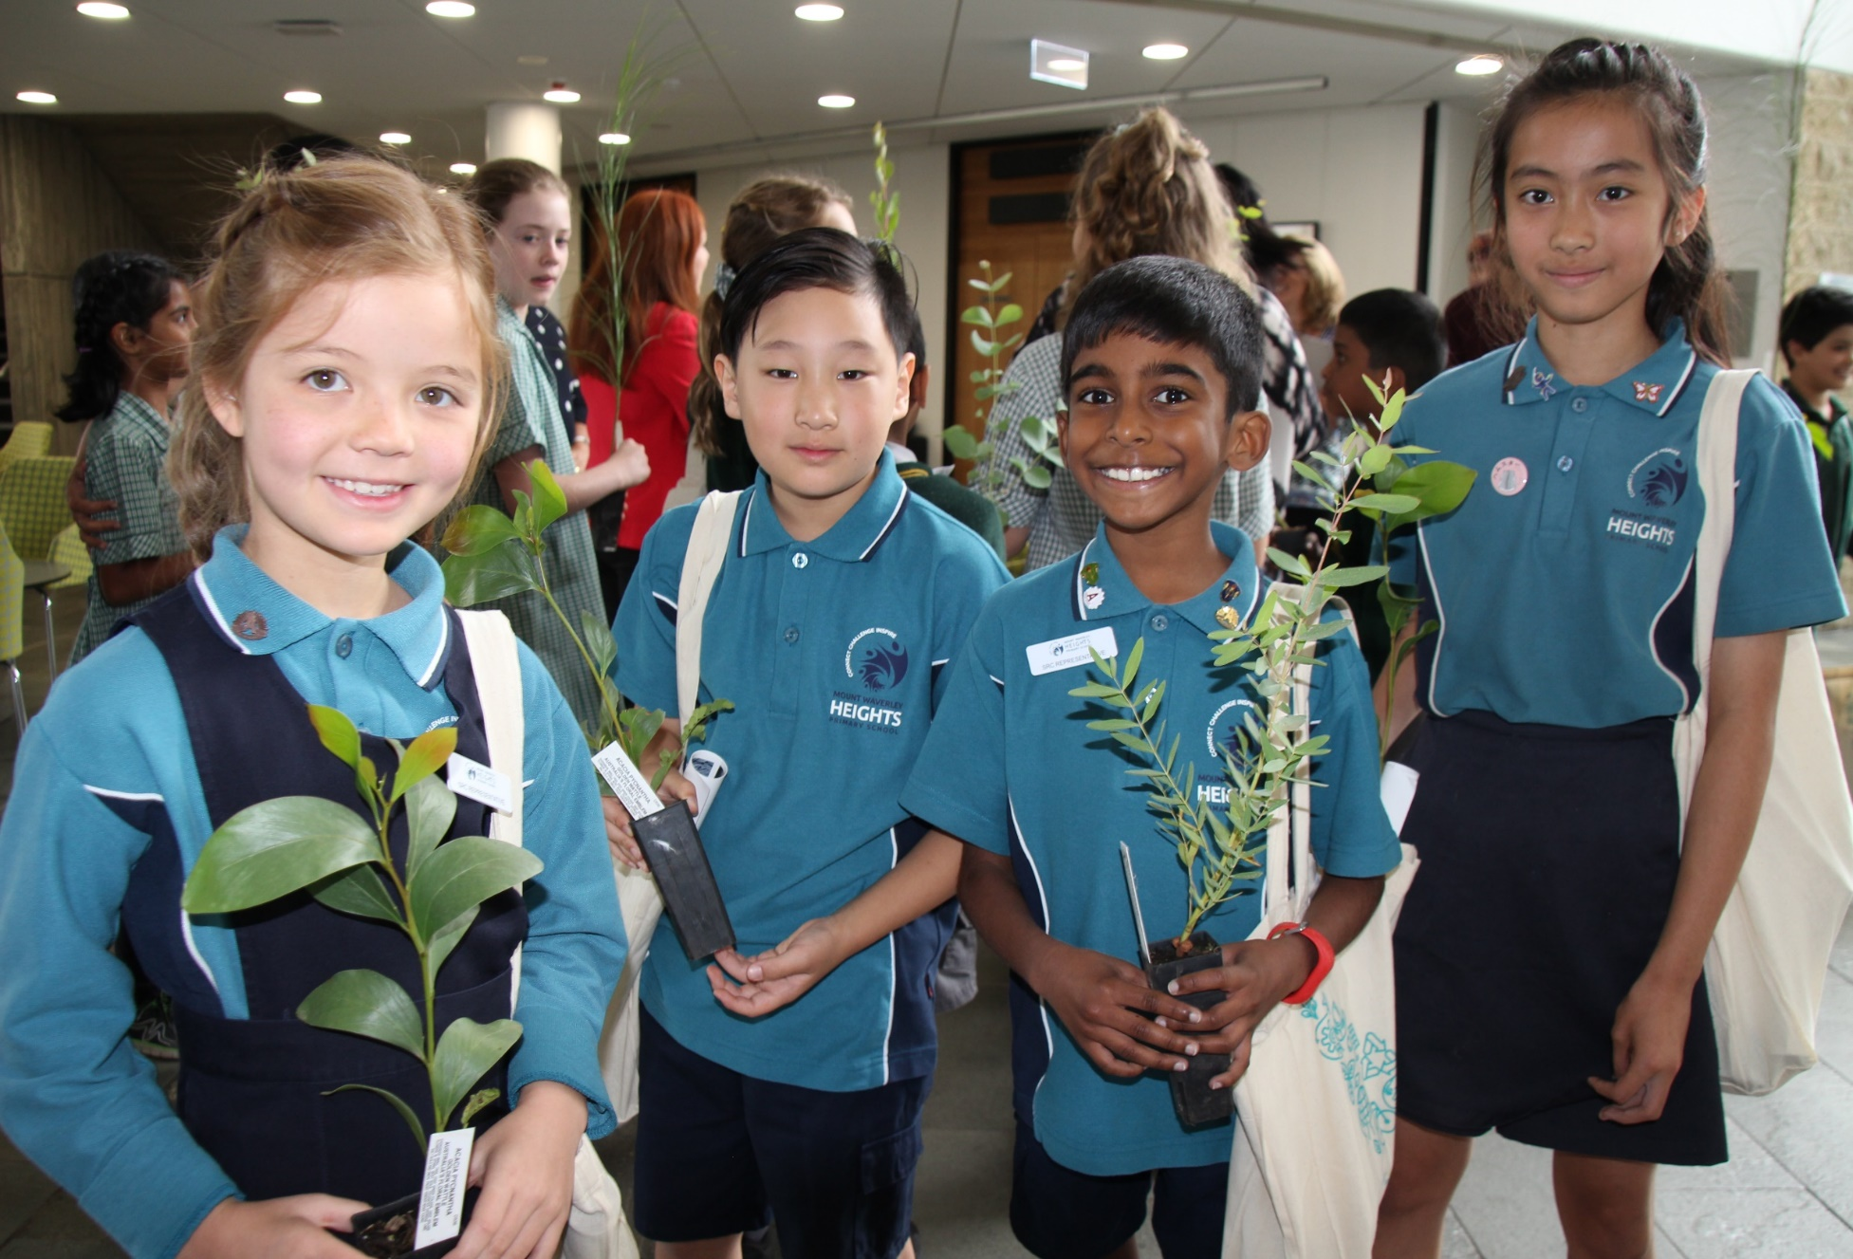
Young People from the City of Monash
Sometimes children are right and adults are wrong
So that they know what they want for dinner
Children are more open minded
Children have bright ideas – adults are stuck in their ways
Not listening can hurt a child’s feelings
So that adults know what’s going on and be more supportive?
Children have been in school longer than adults
So that they can be safe
Children might have good ideas – kids use them, adults don’t
A Childs idea might attract more children
Because adults are too busy
Because adults don’t trust children
When adults don’t listen to children it feels like they don’t care
Children are the next generation – we can shape society

Slide 11
Young People from the City of Port Phillip
Early Years
“It’s sad if my mum and dad didn’t listen to me”
“They have to listen to you so they can help you. They can help you keep your body safe and buy food for you”
“I would feel sad if adults didn’t listen to children”
“It wouldn’t be fair if only adults talked and not children”
Middle Years
“Because adults have had their fair share of being in charge for hundreds of thousands of years and kids are more creative and fun, so they should be listened to”
“As you know, kids are the best. They also have the right to speak. If adults don’t listen they could ruin our future and education”
“Kids are the future and if they don’t speak now and adults don’t listen to us kids we will have to go to space because of all the rubbish and pollution”
Young People
“Youth have always been at the forefront of social changes. Youth have the benefit of breathing fresh air into old problems, bringing new ideas, energy and rejuvenation where ever they go. Youth have always, and will always be the leaders of society into the future”
“Because old people’s mind’s aren’t what they used to be”
“Because we’ll be in charge of their pensions and we will have to co-exist in a world together maintaining a healthy dialogue that will improve everyone’s lives”

Slide 12
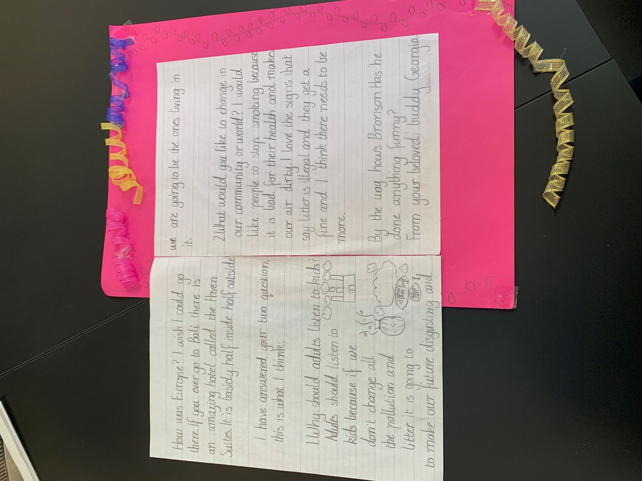

Slide 13
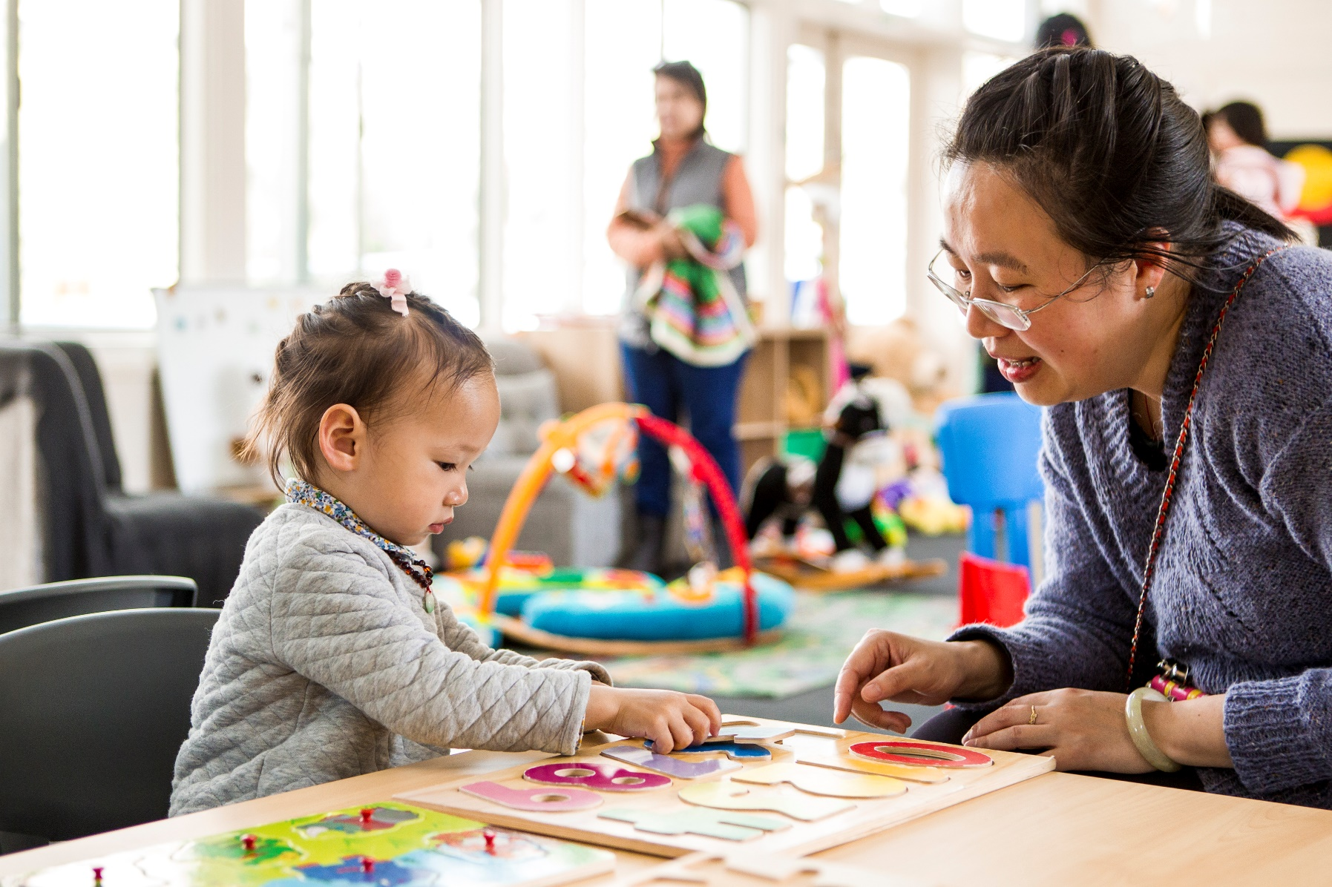
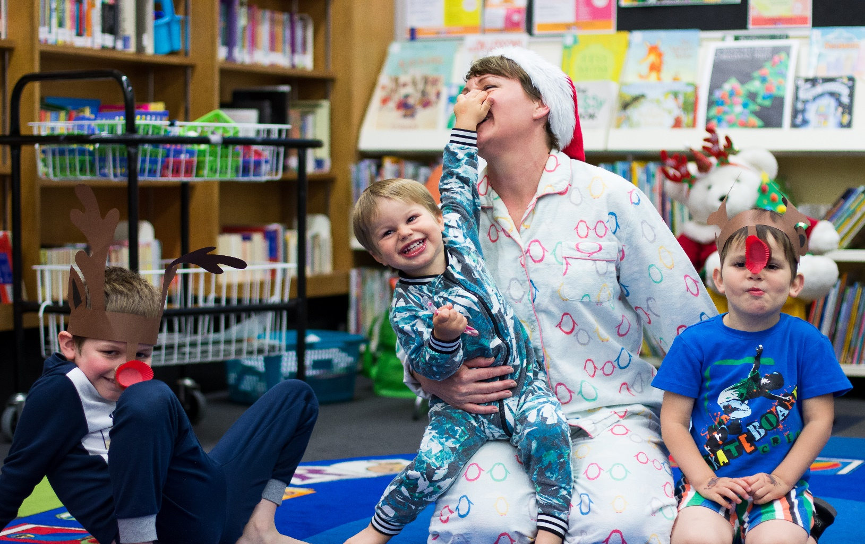
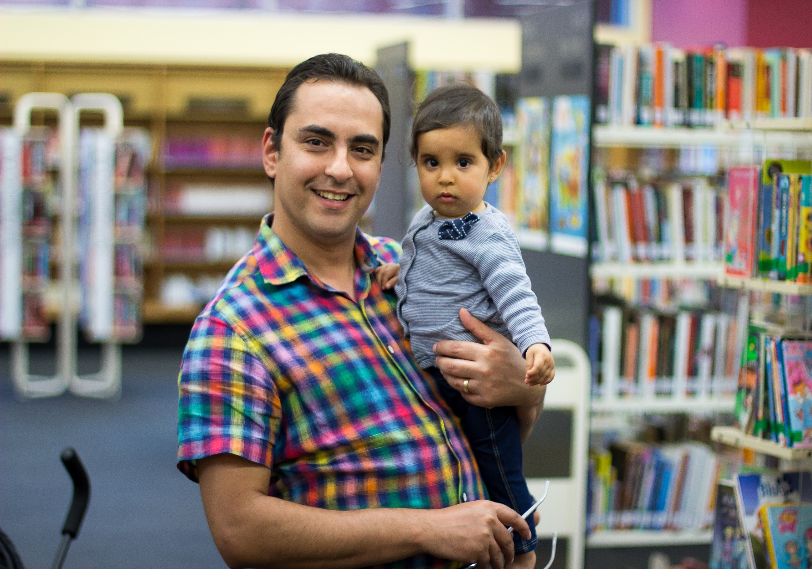
Thank you to everyone that participated – if you haven’t already, take the time to reflect with the young people in your community and ask “Why should adults listen to children?” you might be surprised with the answer.

