Slide 1
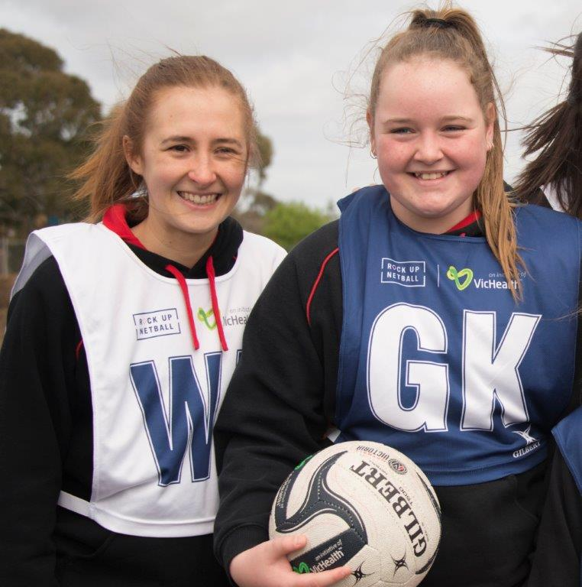
CHARTER SIGNATORIES
The following Organisations have endorsed the Victorian Charter for Child Friendly Cities and Communities and have received recognition from the VLGA.
Brimbank City Council | Whitehorse City Council | Nillumbik Shire Council
Darebin City Council | Boroondara City Council | Moonee Valley City Council
Whittlesea City Council | City of Greater Bendigo | Port Phillip Council
Maribyrnong City Council | Ballarat City Council | Baw Baw Shire Council
Melton City Council | Moreland City Council | Greater Dandenong City Council
Cardinia Shire Council | Bass Coast Shire Council

