Slide 1

Communities for Children Children’s Voice
Projects

Slide 2
Overview
Communities for Children
Children’s Voice projects
  Voicelab consultations
  CfC Logo Competition
Sharing outcomes with Children
Learnings

Slide 3
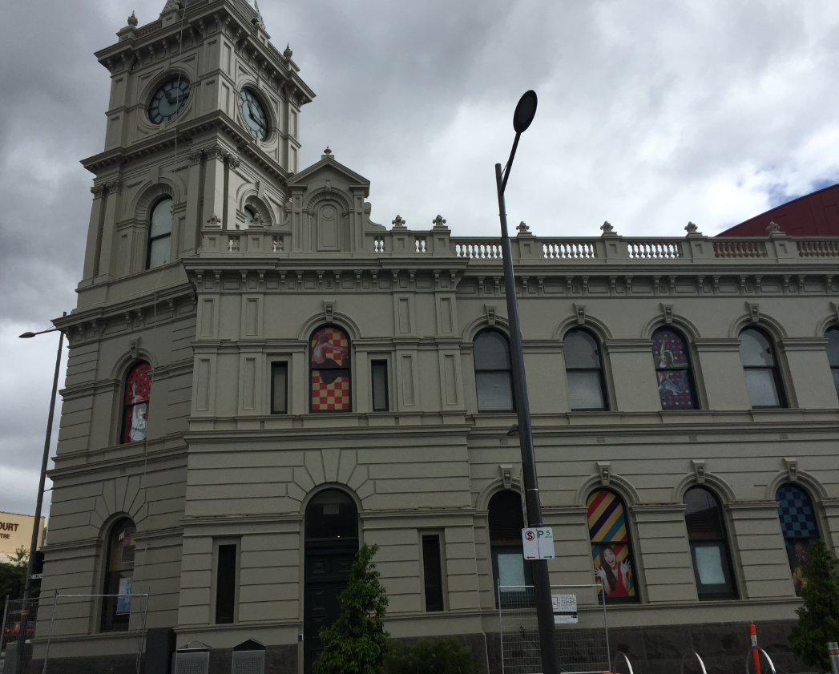
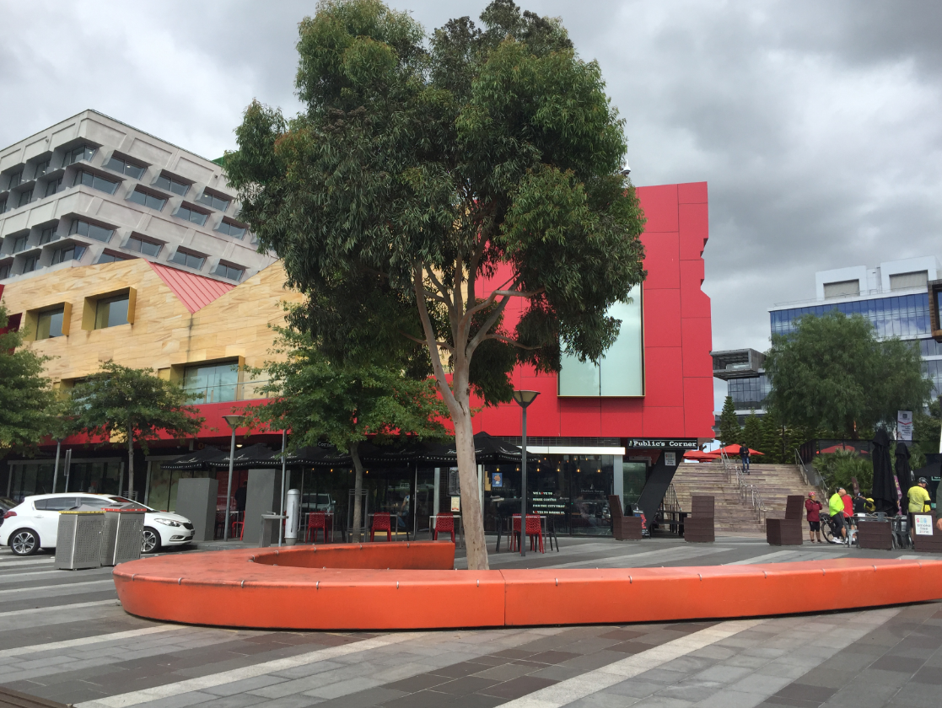
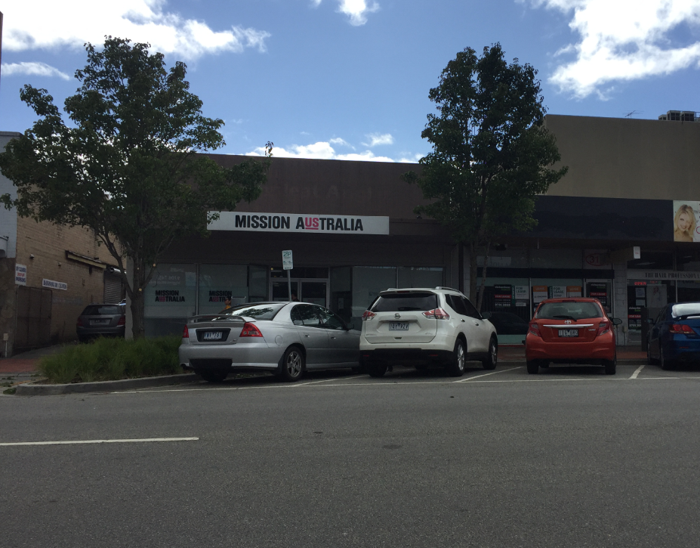
Communities for Children
Dandenong

Slide 4
Communities for Children Key Priority Areas
Family Violence
Language, Literacy and Numeracy
Enhancing Parental Capacity
Families experiencing vulnerability, disadvantage and multiple barriers to participation

Slide 5
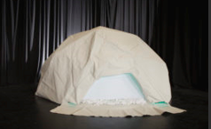
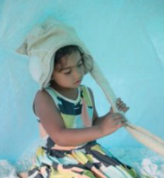
Voice Lab Consultation
‘When children have opportunities to participate and feel their contributions are valued, they are more likely to speak up when harmed or feeling unsafe’.
https://ccyp.vic.gov.au/child-safety/being-a-child-safe-organisation/the-child-safe-standards/standard-7-empowering-children/

Slide 6
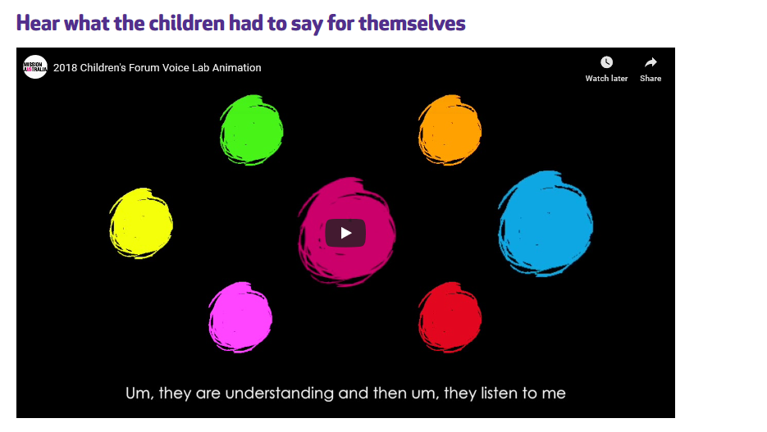
https://youtu.be/469yL1_PZKo

Slide 7

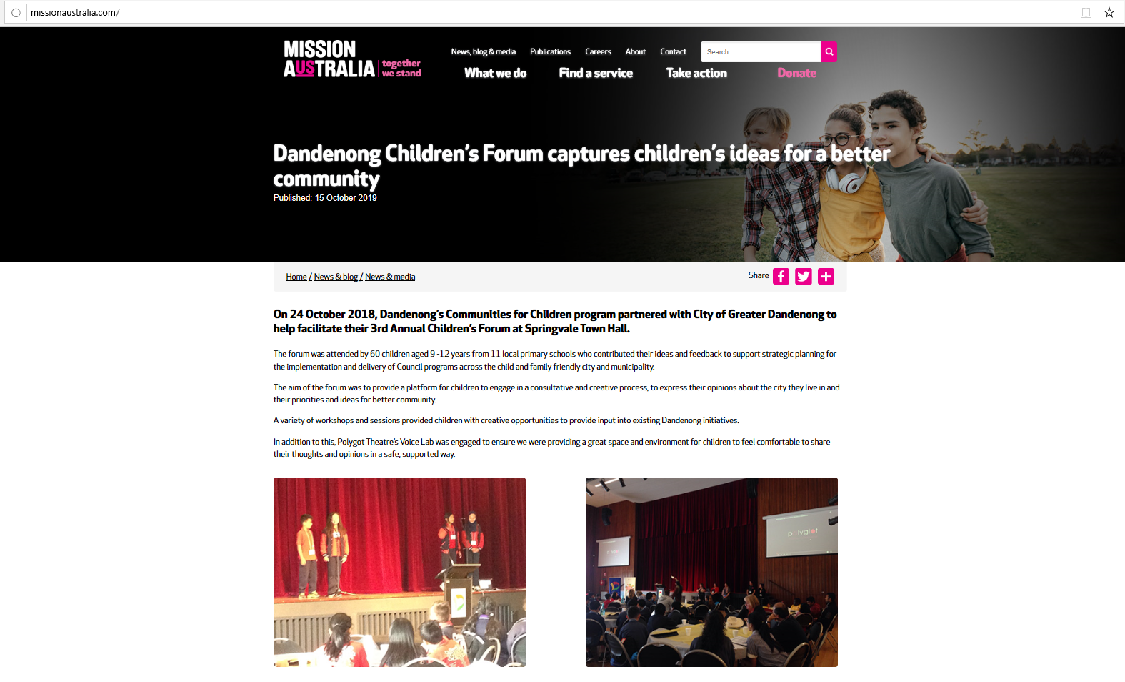
Outcomes of Consultation

Slide 8

Outcomes of Consultation
Yes. Because if you don't help people and families that are in need it will be hard to get through life.
Child Participant CGD Children’s Forum Consultation 2018.
Yes. Because if you don’t feel safe at home you won’t feel safe anywhere else really.
Child Participant, CGD Forum, October 2018

Slide 9
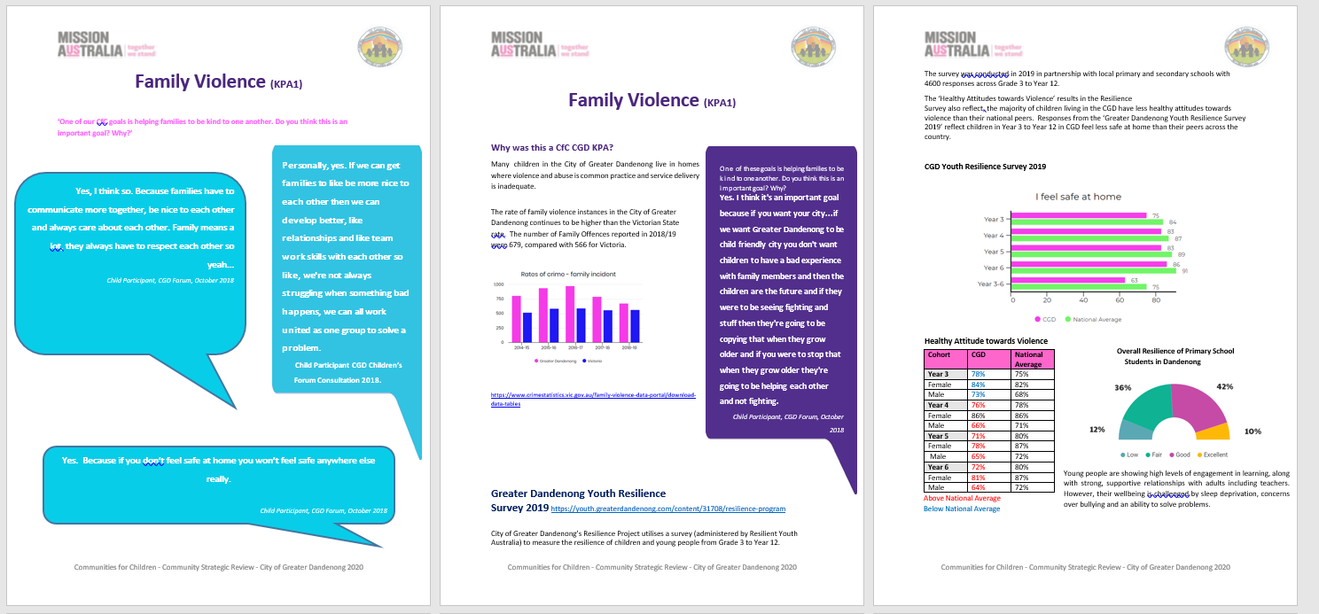
Outcomes of Consultation

Slide 10

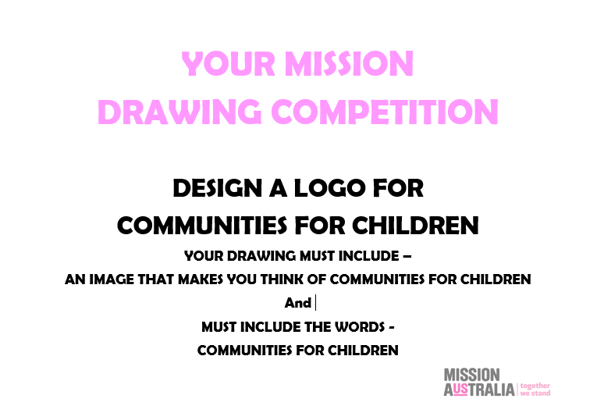
CfC Logo Competition

Slide 11
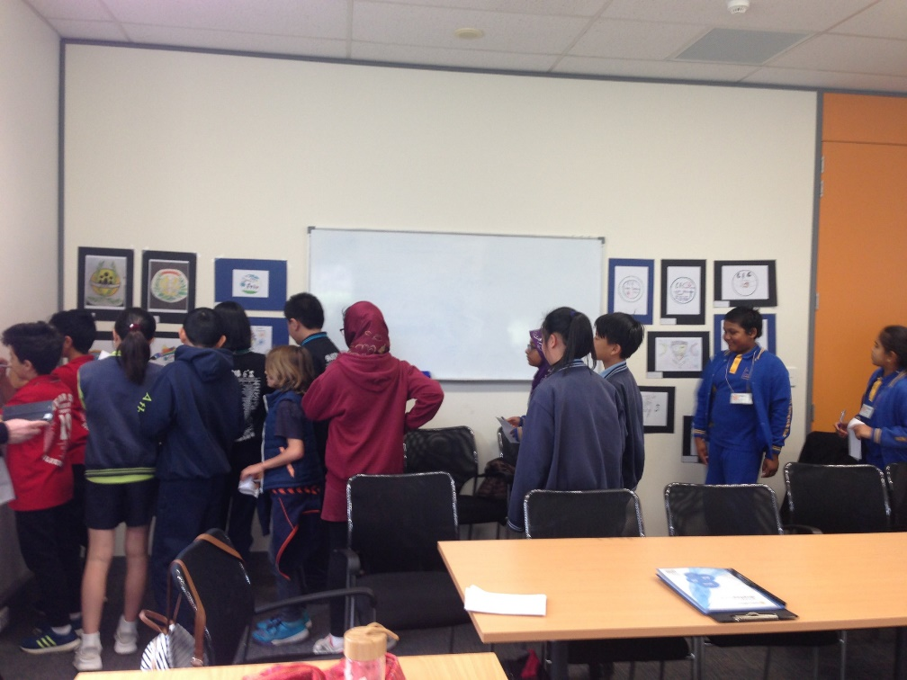
CfC Logo Competition

Slide 12
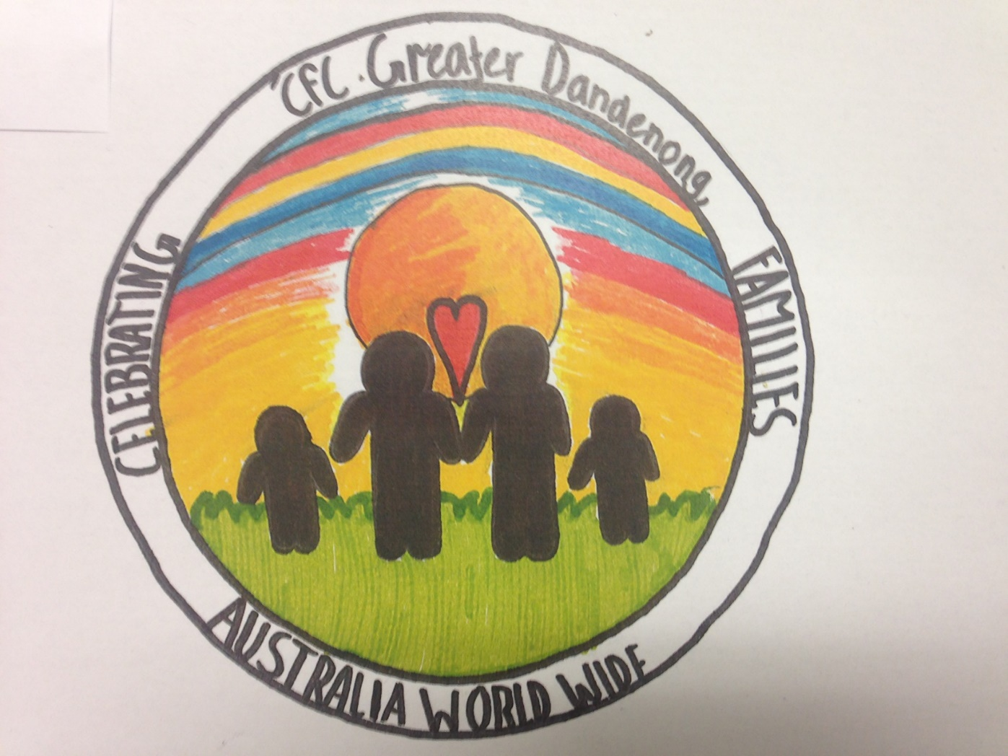
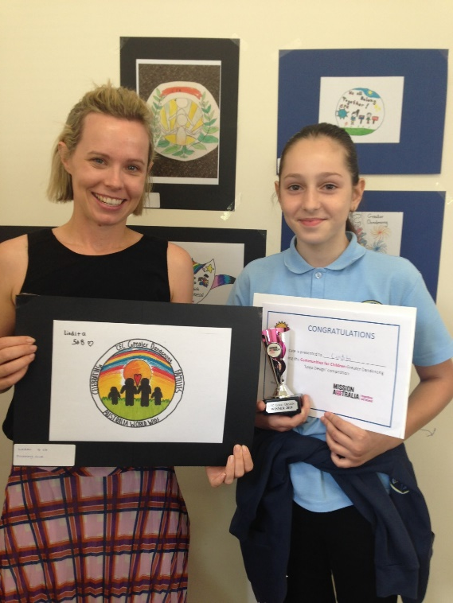
CfC Logo Competition

Slide 13
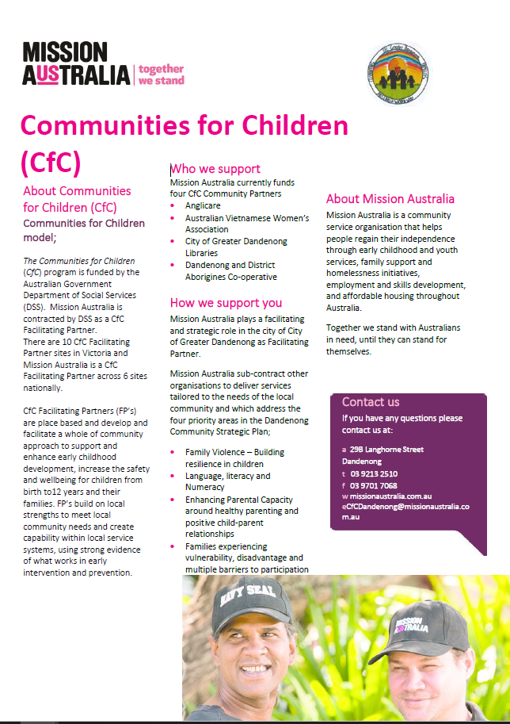
CfC Logo Competition

Slide 14
Learnings
More consultation / less feedback to children
Missing question!
Sharing tangible outcomes with children from consultations is best

Slide 15

Questions?

